Slide 1
Instructions for IEEE UV2026
K-12 Submissions on EasyChair
K-12 Contact: UV-k12@universal-village.org

Slide 2
Outline
1. Create EasyChair Account [Slide 3]
2. Submit a New Paper [Slide 9]
3. Update an Existing Submission [Slide 14]
4. Check Review Results [Slide 18]

Slide 3
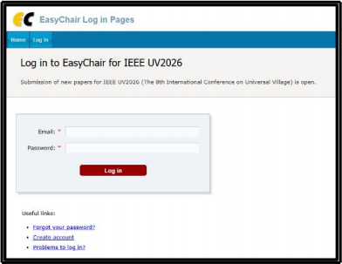
1. Create EasyChair Account-1
1-A) Go to the EasyChair login page:
. EasyChair: Log in（https://www.easychair.org/account/signin）
1-B) Click “Create account” to start the registration process.

Slide 4
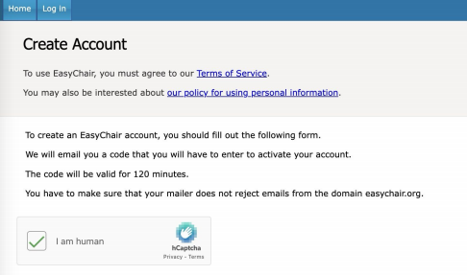
Create EasyChair Account-2
1-C) Complete the human verification (reCAPTCHA) as required.

Slide 5
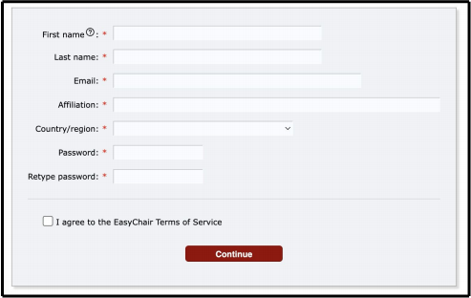
Create EasyChair Account-3
1-D) Fill in your personal information in the registration form.

Slide 6
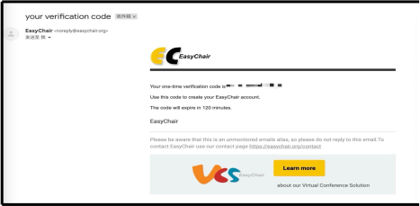
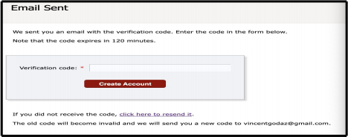
Create EasyChair Account-4
1-E) After submitting the form, a
confirmation message will be displayed indicating that your application has been received.
1-F) Check your email inbox for a
verification message from EasyChair.
1-G) Enter the verification code provided in the email.
1-H) Click “Create account” to finalize your registration.

Slide 7
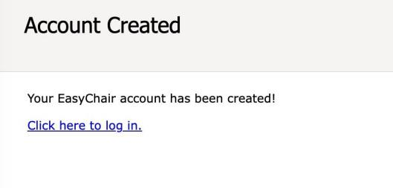
Create EasyChair Account-5
1-I) Click the “Click here to log in” link to access the EasyChair login page.

Slide 8
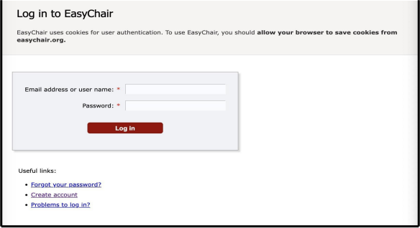
Create EasyChair Account-6
1-J) You can now log in to EasyChair using your registered email address (or username) and password.
○Log in （https://easychair.org/conferences/?conf=ieeeuv2026）

Slide 9
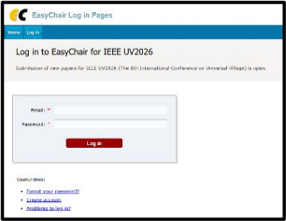
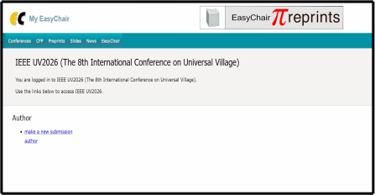
2. Submit a New Paper-1
2-A) Log in to EasyChair:
. EasyChair: Log in
(https://www.easychair.org/account/sig nin)
2-B) Click “Make a new submission” .

Slide 10
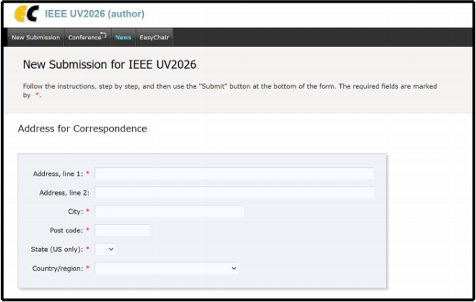
Submit a New Paper-2
2-C) Complete all required fields:
  - Corresponding author information
  - Author details
  - Title and abstract
  - Keywords
  - File upload
2-D) Upload your manuscript as a PDF file.

Slide 11
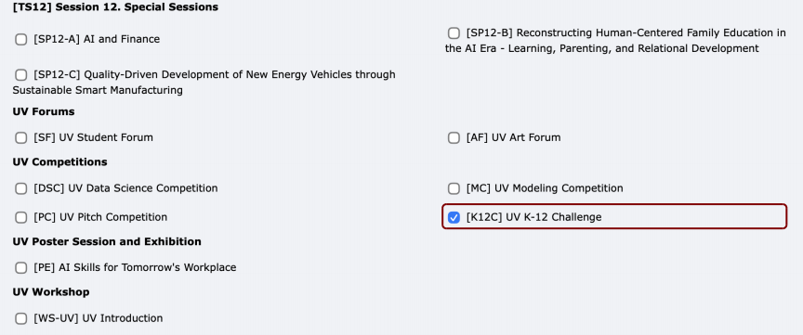
2. Submit a New Paper - Select Category
In the Category section, under UV Competitions, select:
[K12C] UV K-12 Challenge

Slide 12
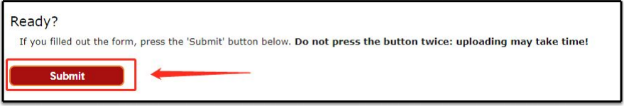
Submit a New Paper-3
2-E) Click “Submit” to finalize your submission.
[Important] Do not create multiple submissions for the same work. Use the update function for revisions (See Section 3).

Slide 13
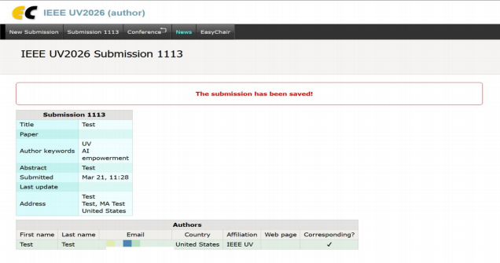
Submit a New Paper-4
2-F) Upon successful submission, the system will display your submission ID and details.

Slide 14
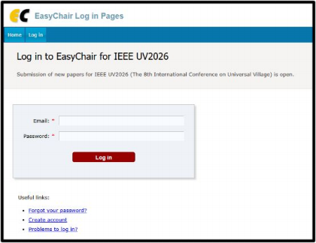
3. Update an Existing Submission-1
3-A) Log in to EasyChair.
. EasyChair: Log in （https://easychair.org/conferences/?conf=ieeeuv2026）

Slide 15
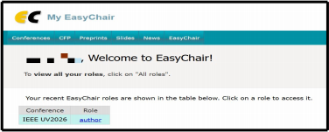
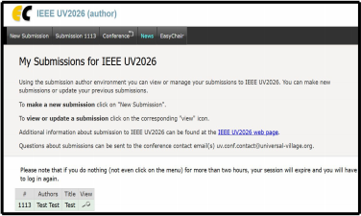
Update an Existing Submission-2
3-B) Select “Author” to access your submission dashboard.
3-C) Locate your submission and click the view icon 回

Slide 16
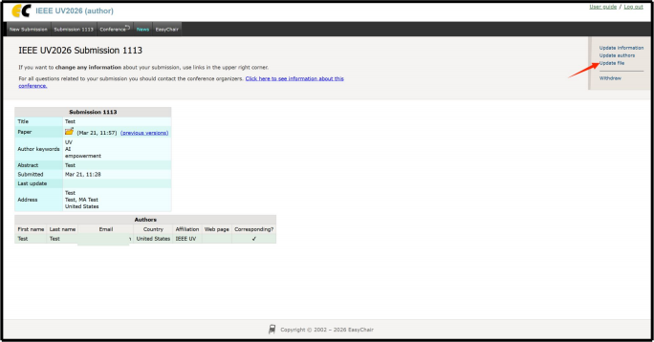
Update an Existing Submission-3
3-D) Click “Update file” .

Slide 17
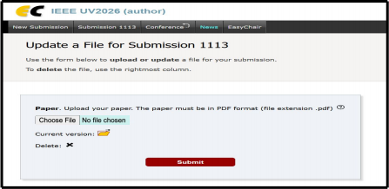
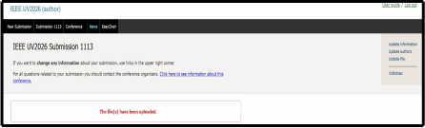
Update an Existing Submission-4
3-E) Upload the revised version of your submission.
3-F) Click “Submit” to confirm the update.
3-G) A confirmation message will indicate that the file has been successfully uploaded.

Slide 18
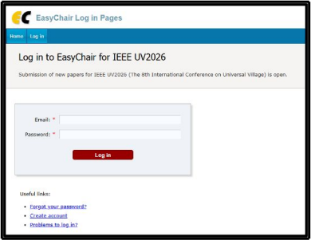
4. Check Review Results-1
4-A) Log in to EasyChair.
. Log in（https://easychair.org/conferences/?conf=ieeeuv2026）

Slide 19
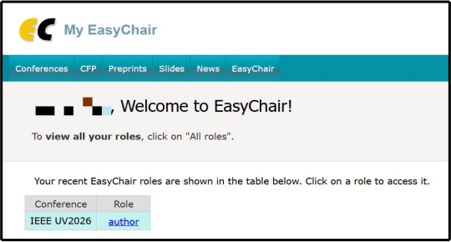
Check Review Results-2
  4-B) Click “Author” to access your submissions.

Slide 20
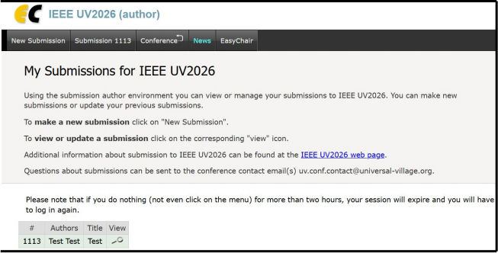
Check Review Results-3
4-C) Select your submission and click the view icon 回 .

Slide 21
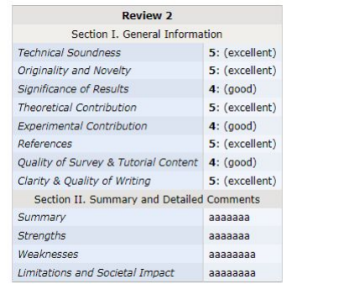
Check Review Results-4
  4-D) Review the reviewer comments displayed on the page.

Slide 22
You are All set!
Thank you!

